Slide 1
Question 01 / PROJECTION works different on BOX and MESH?

Slide 2
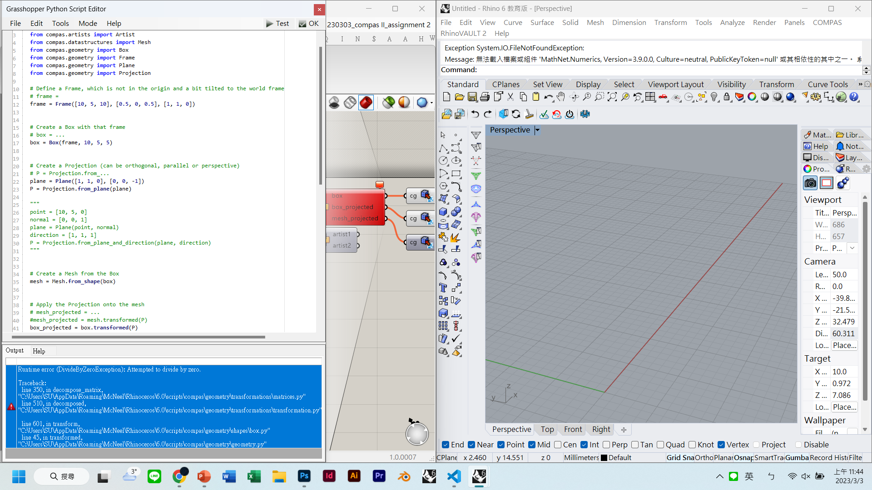
cannot work on BOX

Slide 3
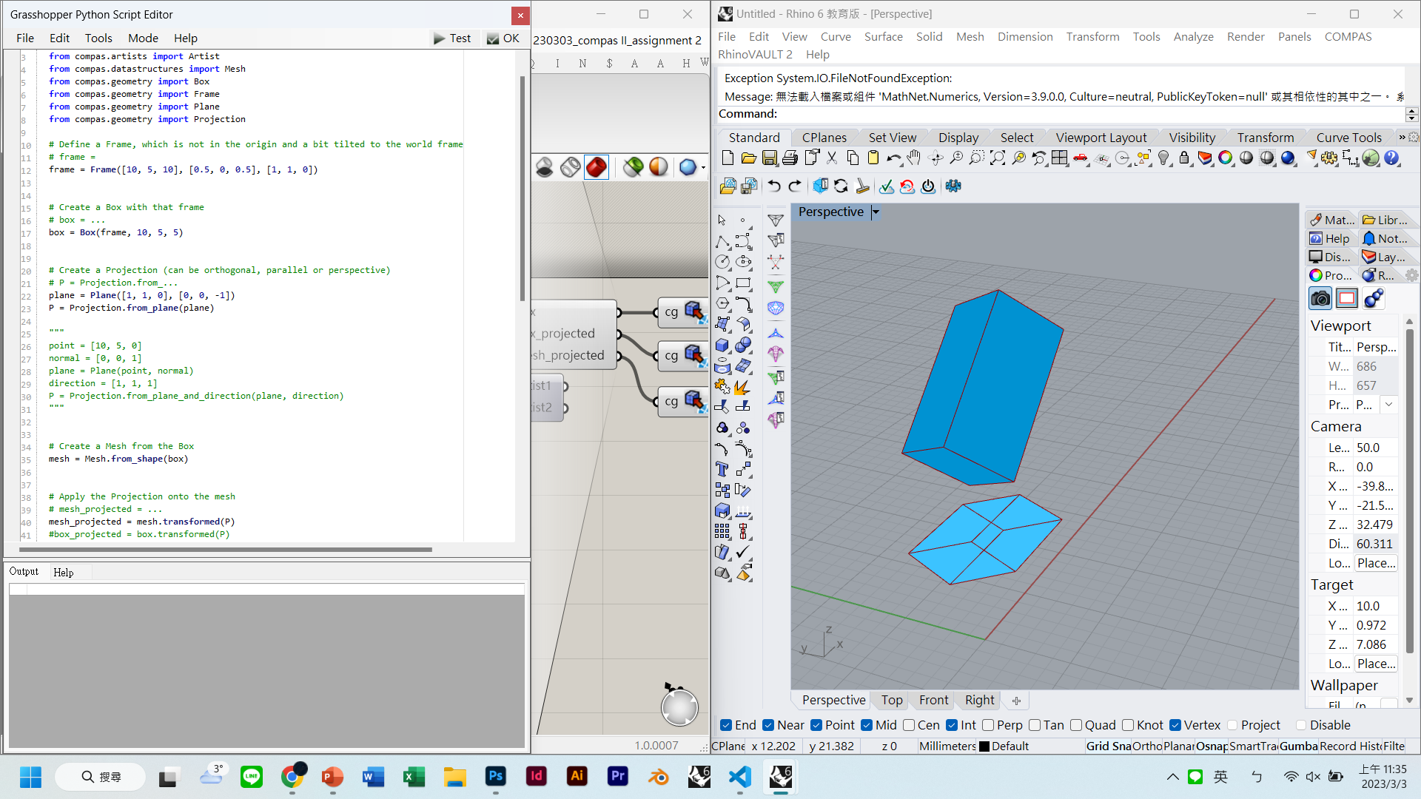
can work on MESH

Slide 4
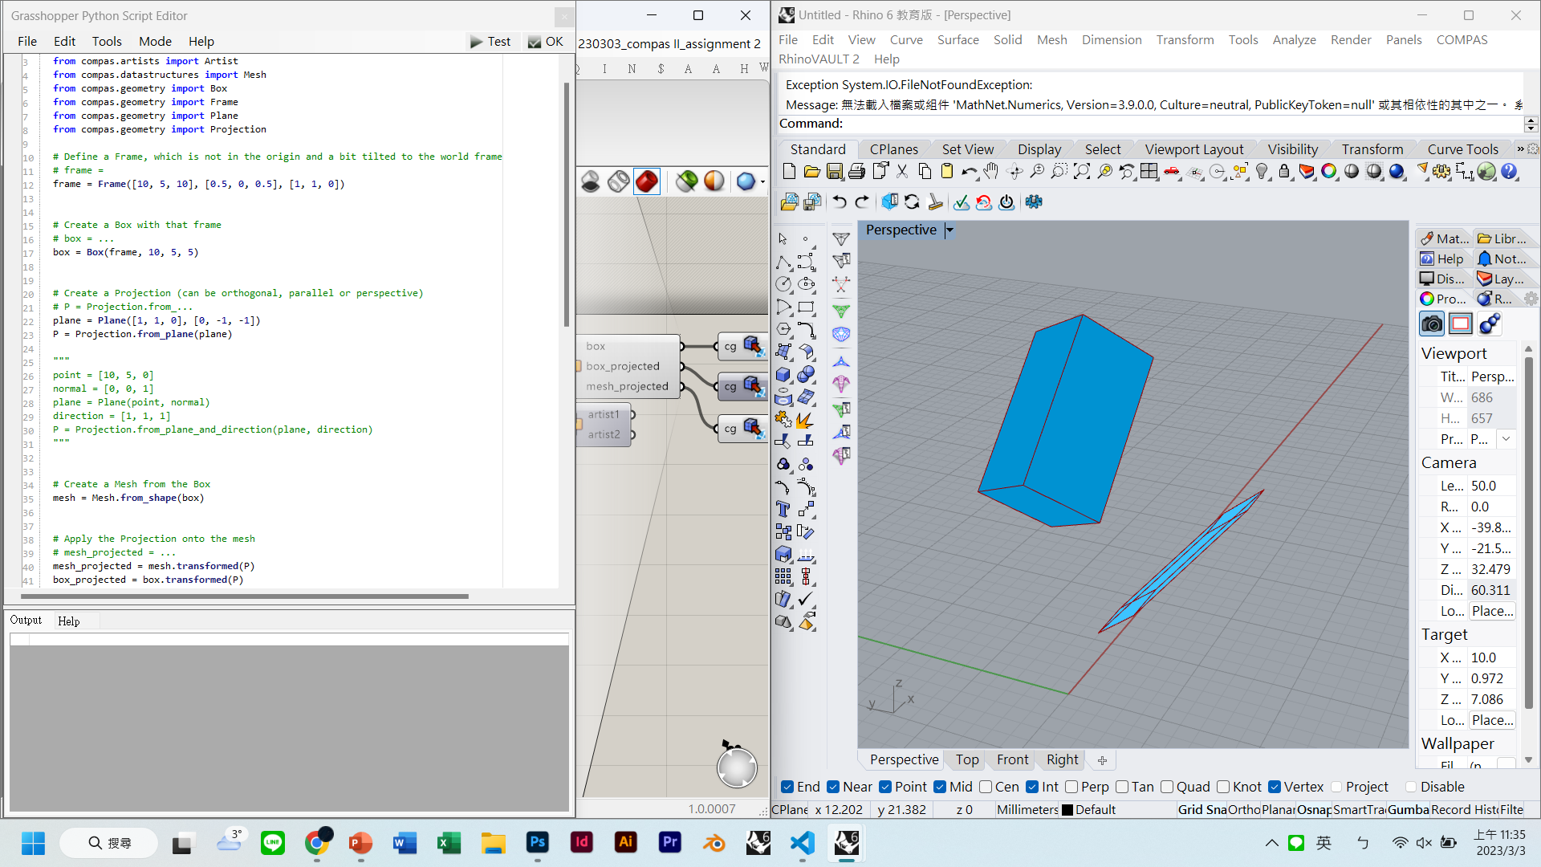
can work on both BOX and mesh

Slide 5
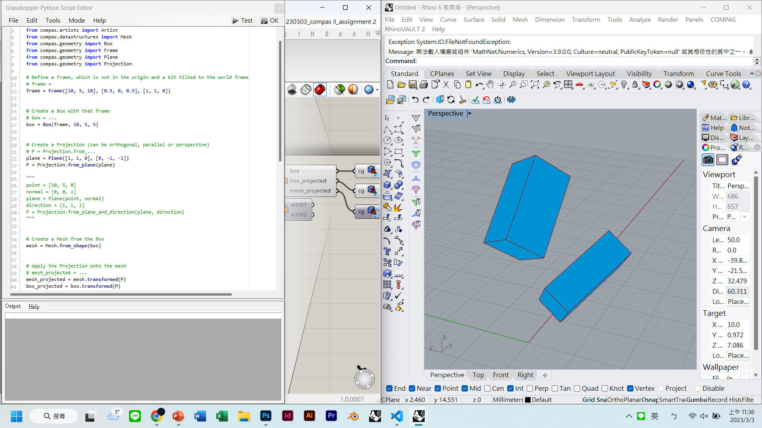
can work on both BOX and mesh

Slide 6
Question 02 / artist1.draw() ?

Slide 7

It can visualize with the plug in

Slide 8
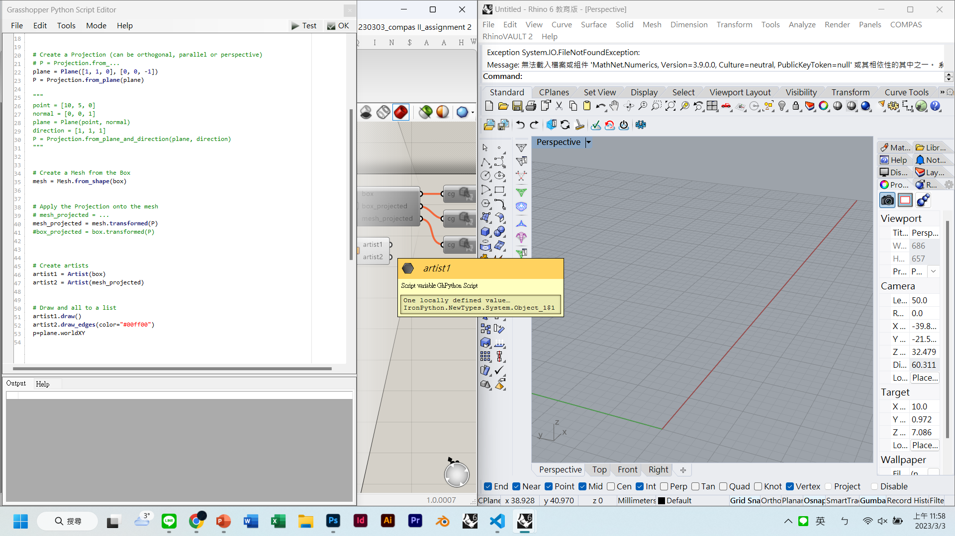
It shows nothing with the artist?

